Slide 1
Publishing options: VSNU institute associated authors

Slide 2
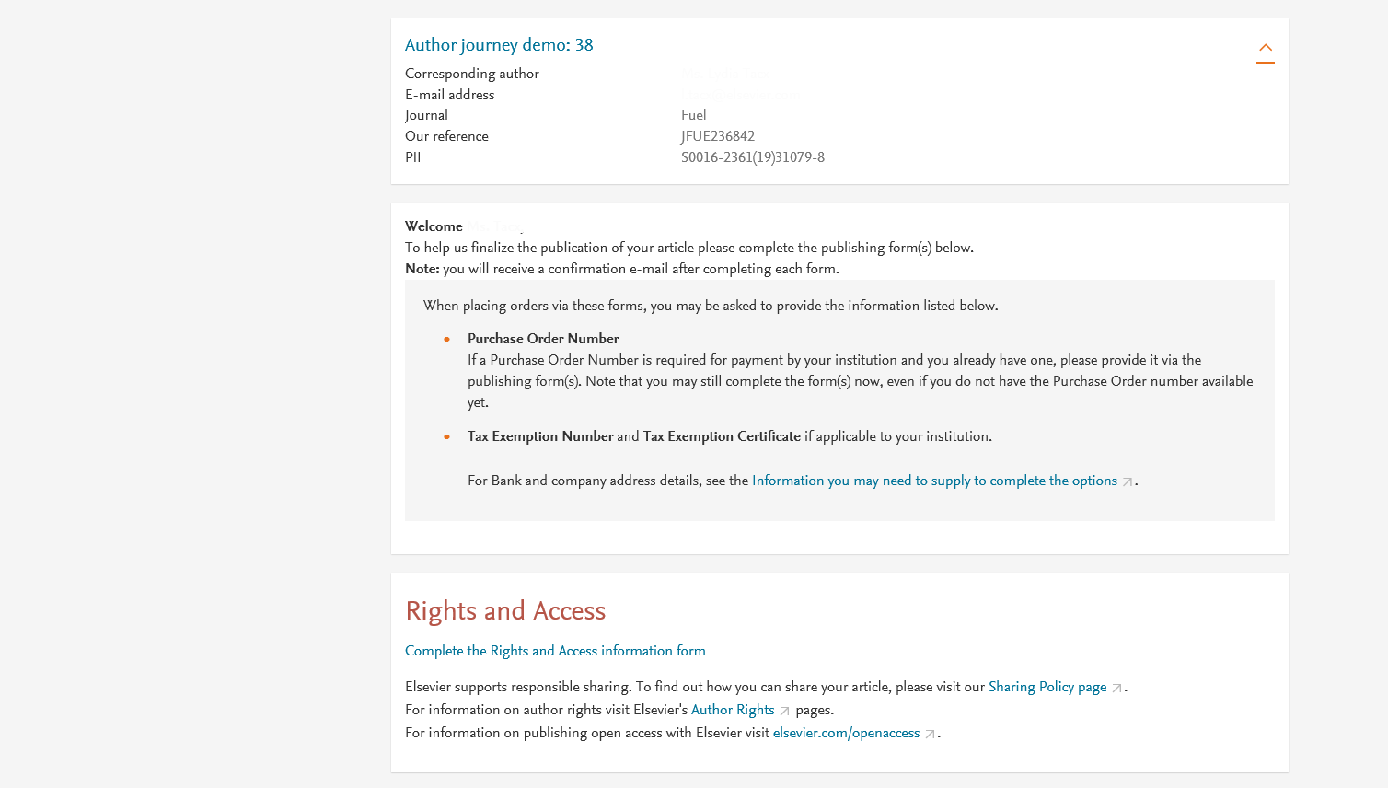
Corresponding author receives an email post acceptance with a link an unique link to complete the author journey and choose publishing options
Author name and email address would appear in the live system

Slide 3
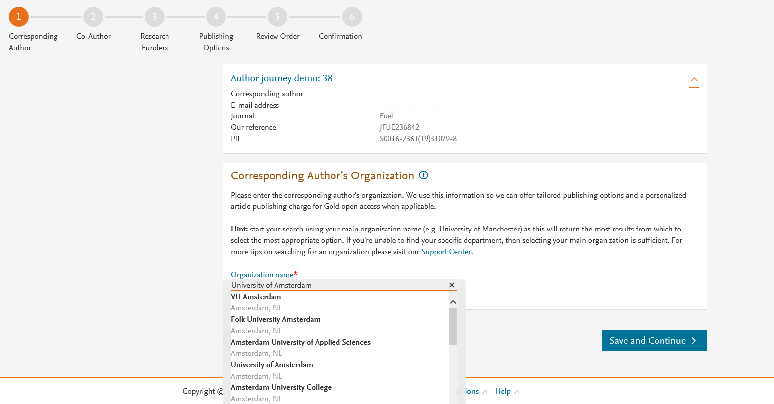
Corresponding author selects his/her affiliation details which we use to identify the authors and match them to the VSNU agreement
In this case author chooses University of Amsterdam

Slide 4
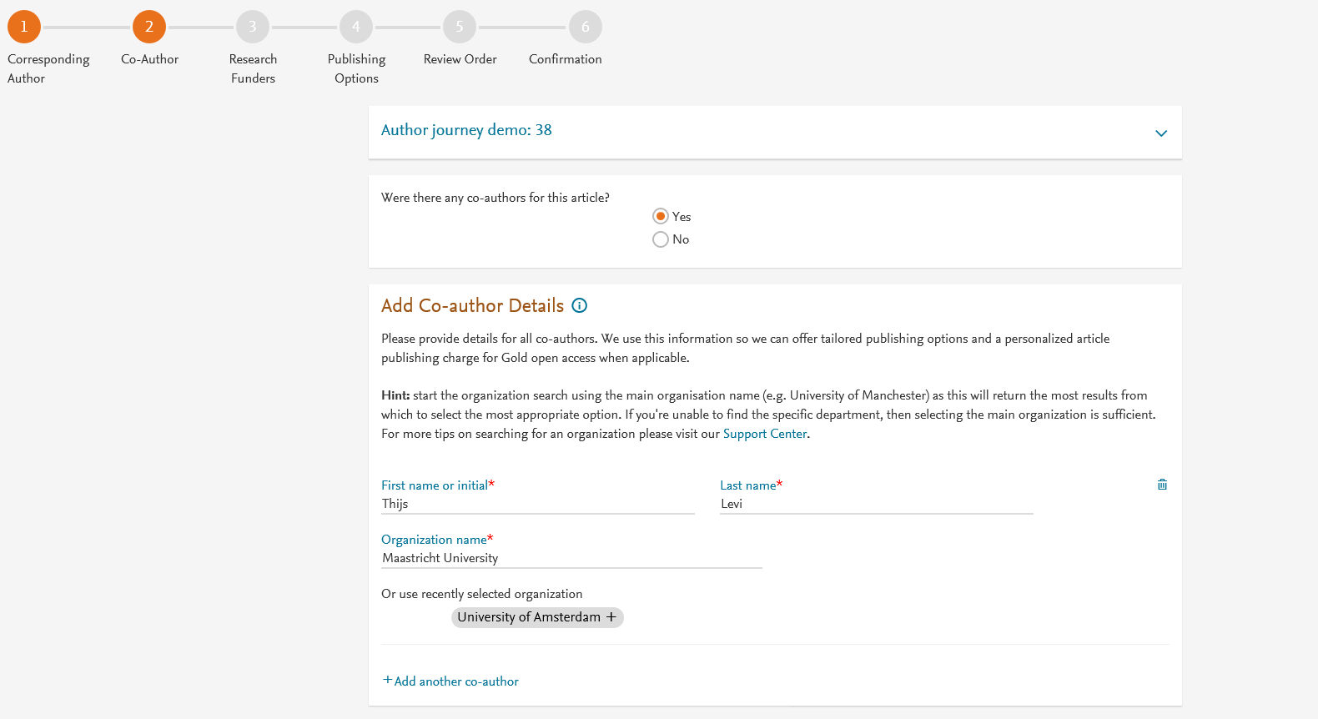
Corresponding author also adds the co-author affiliation details

Slide 5
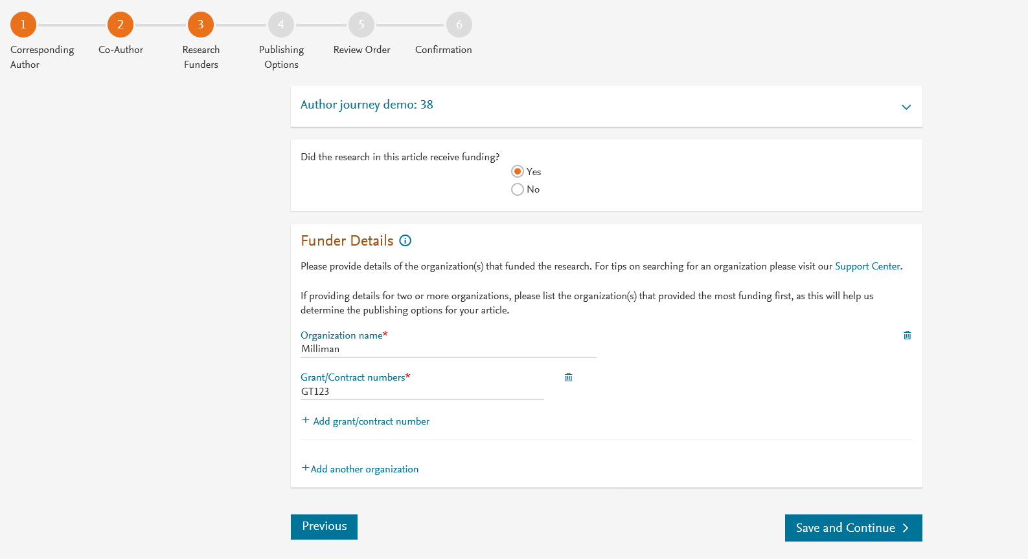
Author can add the Funder details if needed. Funder information is needed when author has received research funding
For VSNU agreement, we only use the corresponding author affiliation to present the VSNU agreement

Slide 6
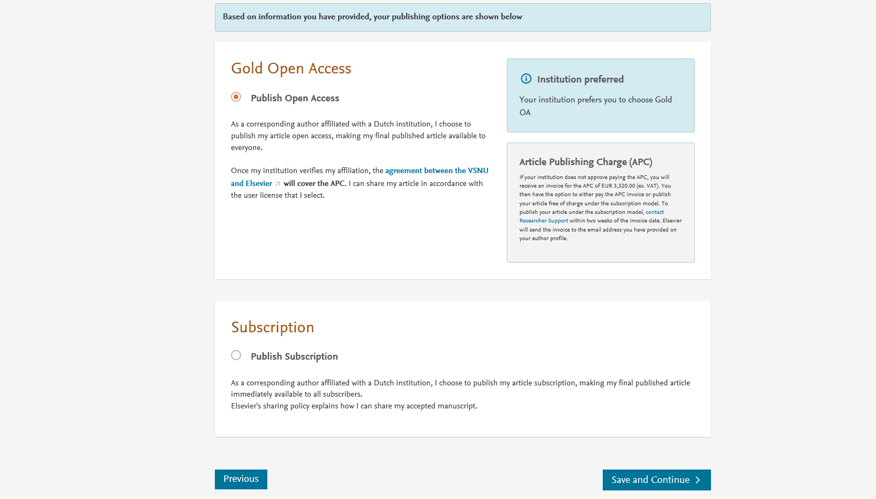
Based on the affiliation details, the author sees the Publishing Options. Gold OA option is followed by Subscription option and we make it clear that agreement covers full APC
If the librarian at the consortium rejects the APC request in the Elsevier OA Platform (EOAP), we also make it clear that the authors will receive a full price invoice
Gold OA is pre-selected in this case

Slide 7
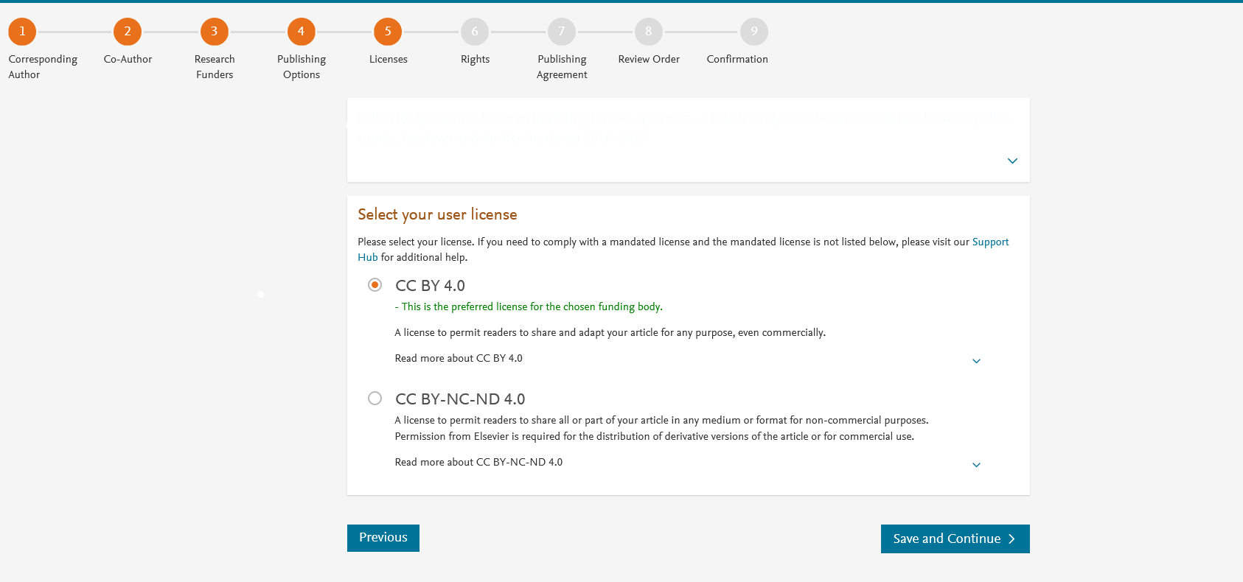
In case of OA, author selects the CC License
Author selects CC BY license in this case

Slide 8
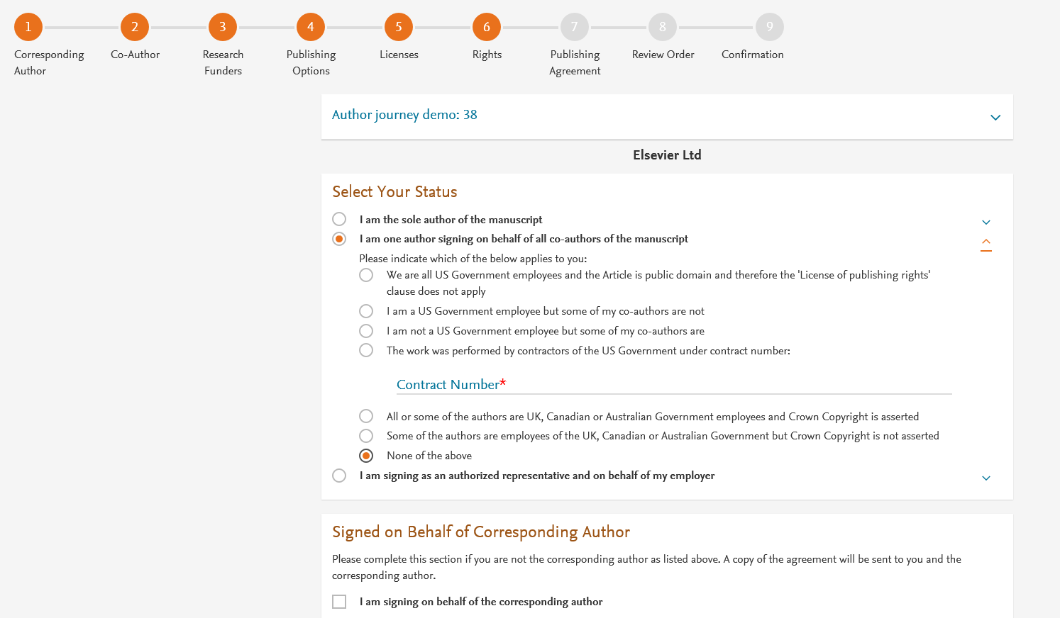
Author selects the rights

Slide 9
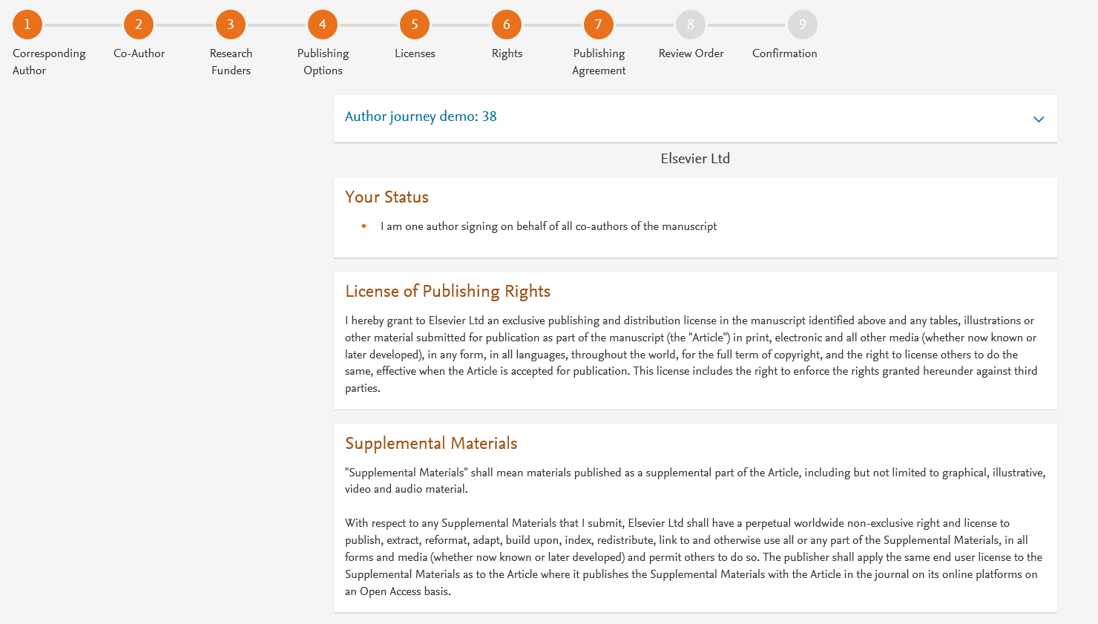
System presents author with the Journal License Publishing Agreement

Slide 10
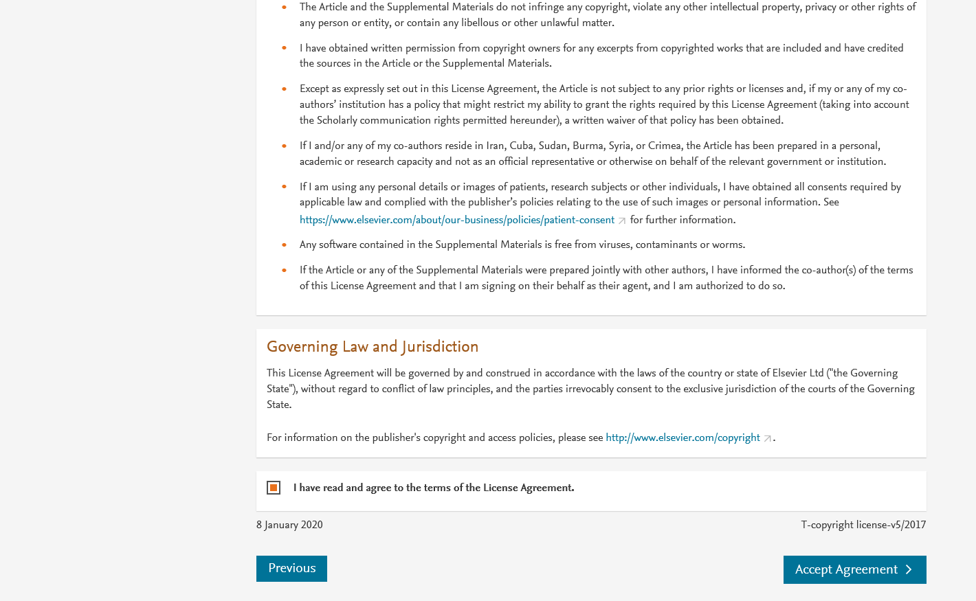
Authors agrees to the Journal License Publishing Agreement

Slide 11
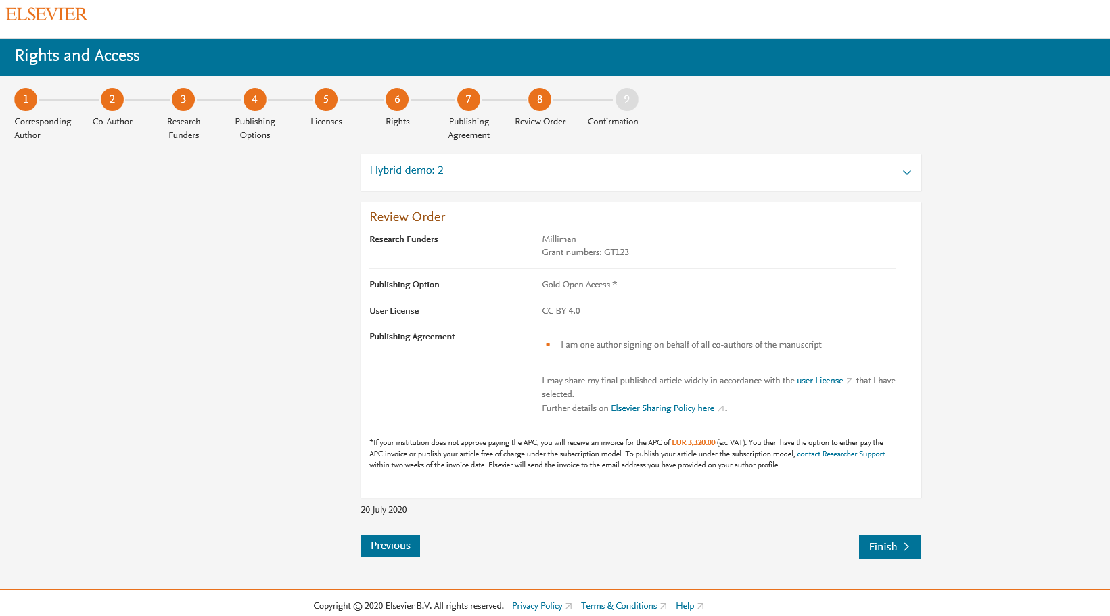
This is the summary page explaining the choices the author made in the publishing journey
Corresponding and Co- authors receive a copy of the summary via email
The article becomes OA on ScienceDirect within 24 hours
The librarian at the institution will receive a request to validate the discount within 48 hours

