Slide 1
VSNU Workflow Screenshots
David Tempest
March 2016

Slide 2
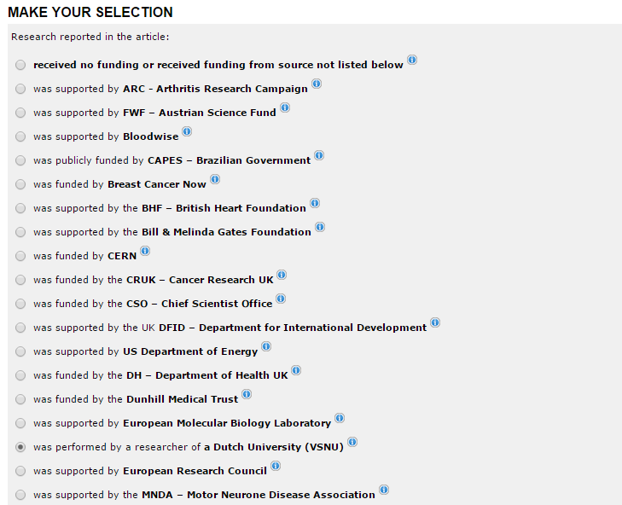
Selection Page

Slide 3
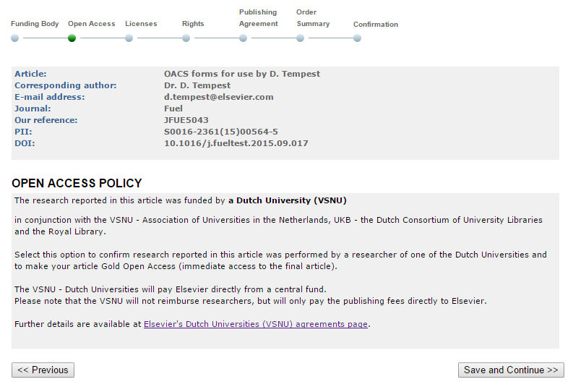
Summary Screen

Slide 4
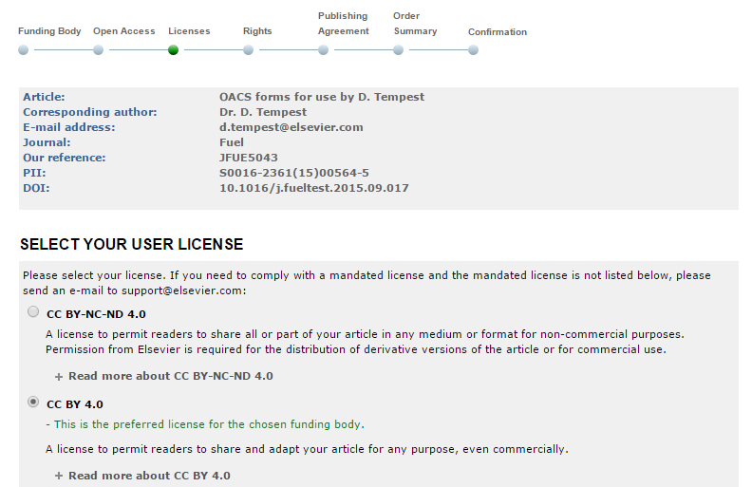
Licence Choice
This is the preferred licence for VSNU

